Slide 1
Vitex negundo

Slide 2
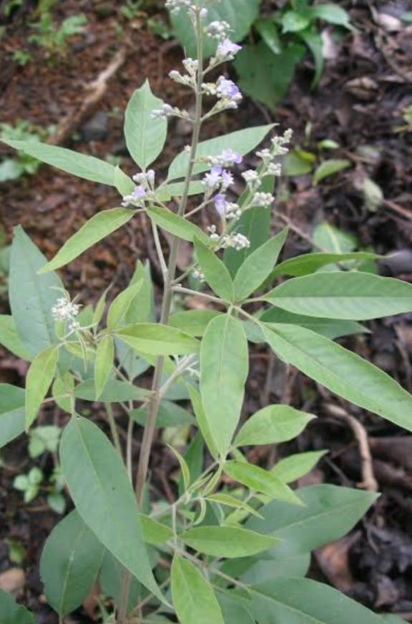
Synonyms : V. bicolor, V. Incisa.
Family : Verbenaceae
Indian name : Nirgunda,Sanbhalu, Sinduari
Distribution : Throughout India
Vitex negundo, commonly known as the Chinese chaste tree, five-leaved chaste tree, or horseshoe vitex, or nisinda is a large aromatic shrub with quadrangular, densely whitish, tomentose branchlets. It is widely used in folk medicine, particularly in South and Southeast.

Slide 3
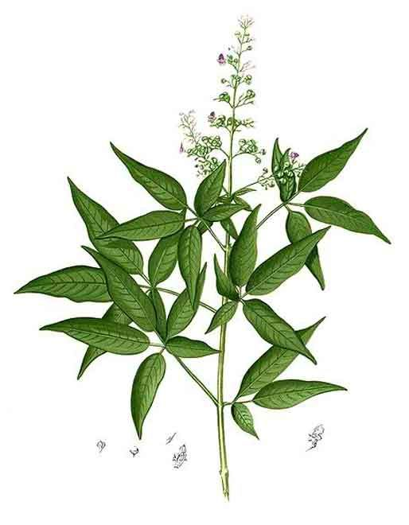

Slide 4
Morphology
Vitex negundo is an erect shrub or small tree growing from 2 to 8 m (6.6 to 26.2 ft) in height. The bark is reddish-brown. Its leaves are digitate, with five lanceolate leaflets, sometimes three. Each leaflet is around 4 to 10 cm (1.6 to 3.9 in) in length, with the central leaflet being the largest and possessing a stalk. The leaf edges are toothed or serrated and the bottom surface is covered in hair.
The numerous flowers are borne in panicles 10 to 20 cm (3.9 to 7.9 in) in length. Each is around 6 to 7 cm (2.4 to 2.8 in) long and are white to blue in color. The fruit is a succulent drupe, 4 mm (0.16 in) in diameter, rounded to egg-shaped. It is black or purple when ripe.

Slide 5
Uses of root
Decoction of roots given against chronic fever, body pain, indigestion or skin diseases.
Extract of its roots (2tsp) mixed with tender coconut water given twice daily for seven days to check burning sensation of urination and kidney stones.
Mixture of paste of its roots along with that of Cynodon dactylon and lime juice applied externally against eczema.

Slide 6
Uses of leaves
Dried leaves smoked for checking cough and headache.
Juice of leaves applied on scalp for supporting hair growth.
Juice of leaves given for digestive disorders and expelling worms.
Poultice of its leaves grounded with salt and pepper bandaged for setting fractured bones.
Leaf paste with garlic given orally for checking stammering.

Slide 7
Uses of flowers And fruits
Infusion of flowers considered useful against heavy menstrual discharge.
Dried fruit powder given for expelling worms .
ACTIVE CONSTITUTENTS
Iriod glycosides,cucubin,agnuside, nishindaside, negundoside.

Slide 8
Major ayurvedic formulations
Himacolin cream, Nirgundi-ghrit, Nirgundi-kwath, Pilex, Rumalayas, Varnasodhana-taila.
Nirgund kalpa, Nirgundi taila,Vacadi taila, Rasnadi taila, Jatyadi taila, Vatagajankusa rasa, Dasamula taila, Trivikrama rasa, Candanadi taila, Sarasvatarista.

